Slide 1
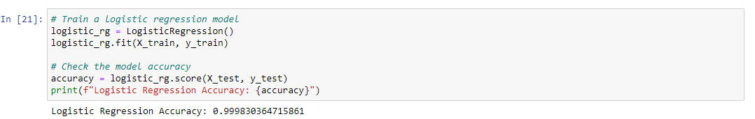
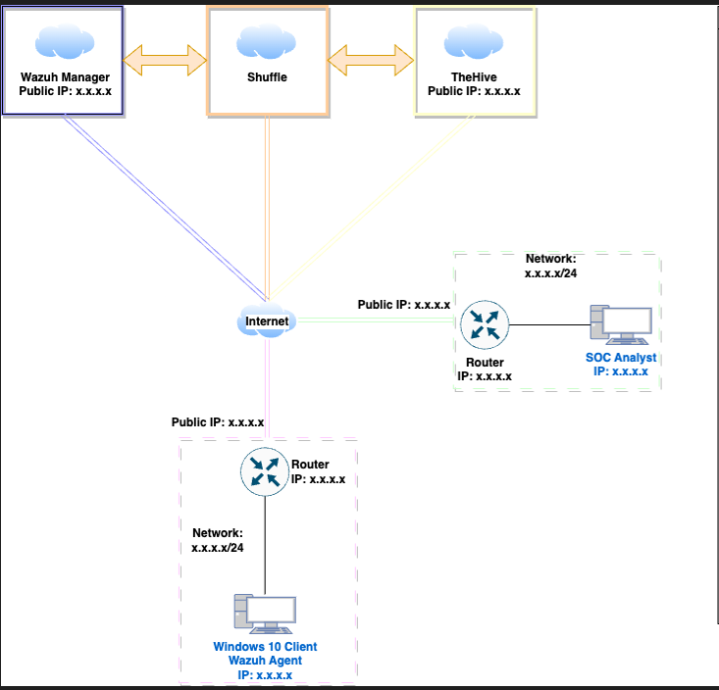
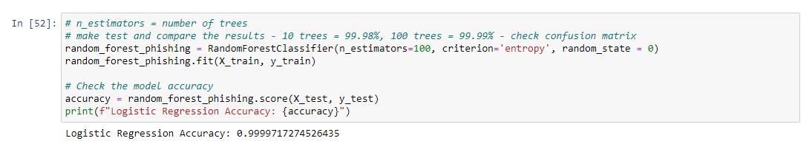
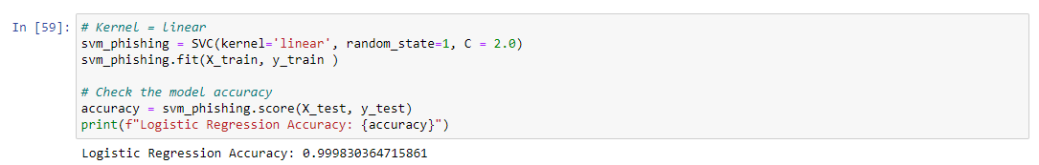
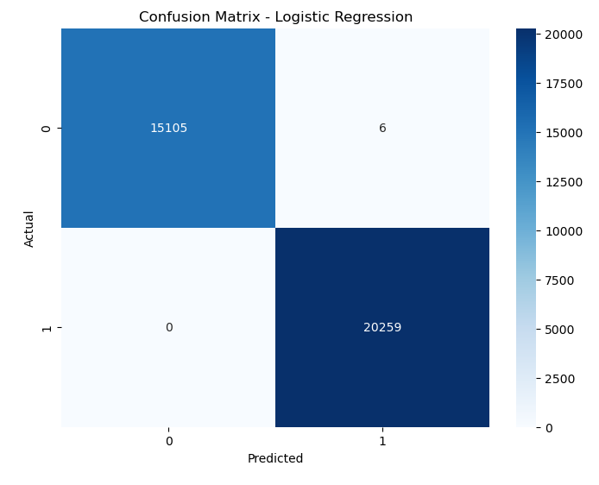
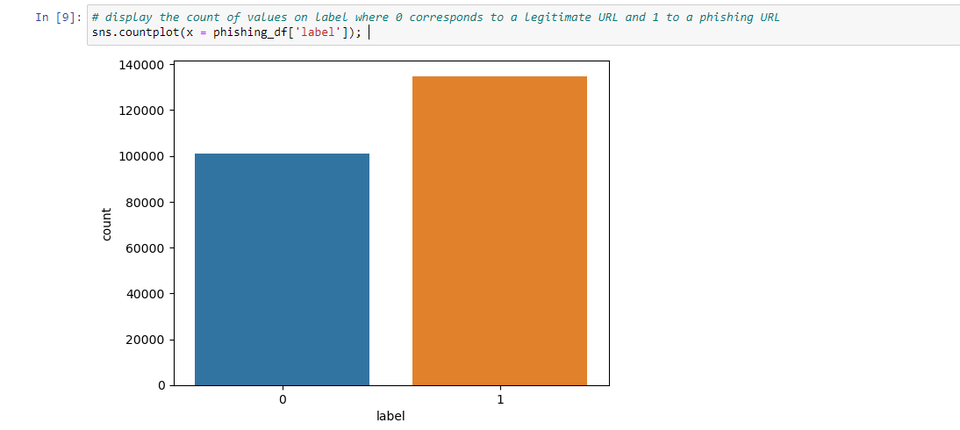
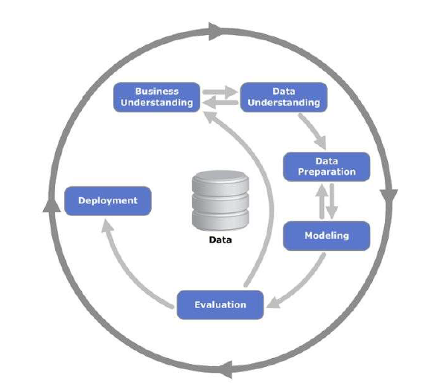

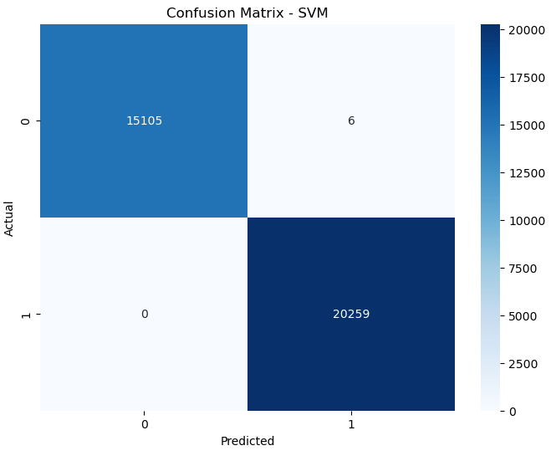
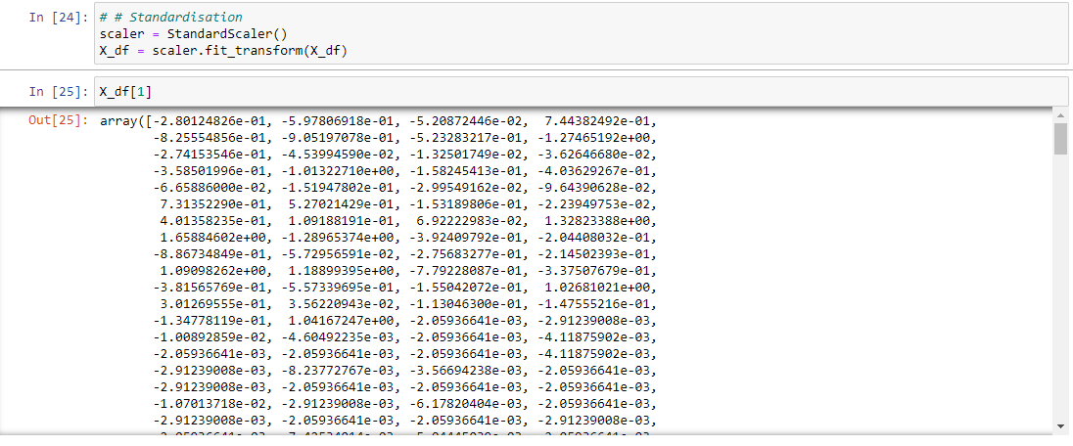
Automated Security Operations Solutions
Yuri Mendonca Ribeiro - 2020347
ABSTRACT
Business Understanding
MODELLING
DEPLOYMENT
Developing an automated Security Operation Centre solution (SOC) integrating Wazuh (SIEM & XDR), TheHive, and Shuffle to provide a centralised, cost-effective, and customisable solution for security monitoring and intelligent response.
Using machine learning algorithms and a phishing URL dataset to enhance the intelligent response capabilities within the SOC.
The project will cover open-source tools, business analysis, data analysis, legal ethical considerations about data in cyber security.
The Automated Security Operations Solutions project aims to build an open-source security operation centre platform by integrating:
• Wazuh (SIEM – Security Information and Event Management & XDR – Extended Detection and Response).
• TheHive (Case Management) and,
• Shuffle (SOAR – Security Orchestration, Automation and Response).
Using machine learning to enhance phishing detection to prevent stealing of private and sensitive information
In the fourth phase of the CRISP-DM process, I have chosen to train three different machine-learning models:
• Logistic Regression – 99.98%
• Random Forest – 99.99%
• SVM model – 99.98%
In the final phase of the CRISP-DM process, the goal is to create a plan for integrating the machine learning model for phishing URL detection into the workflow of the Automated Security Operations Centre (SOC) solution.
Given the Random Forest model has achieved an accuracy of 99.99%, will be deployed for real-time detection of phishing URLs. The model can be integrated with the Wazuh SIEM to analyse network traffic.
Whenever a new URL request is made from any monitored device, the URL will be passed through the trained Random Forest model, the model will then classify the URL as either legitimate or a phishing threat. If classified as a phishing threat, an alert can be automatically generated within Wazuh and then passed to TheHive system for further analysis by a security analyst.
METHODOLOGY
• Business Understanding: Determining business objectives; Identifying the threats that the SOC aims to address; Understanding the tools, and technologies used in the SOC
• Data Understanding: Identifying the relevant data sources for the project and explore and analyse the data to understand its structure, quality and potential limitations.
• Data Preparation: Performing data cleansing and normalisation. Selection and extraction of relevant features from the data set for ML modelling; Handling missing values, and imbalanced data, if necessary; Splitting the data into training and testing sets.
• Modelling: Choosing the machine learning algorithm for phishing URL detection.
• Evaluation: Evaluation of the performance of the models; Interpretation of the model’s result.
• Deployment: Creation of a plan for integrating the machine learning model into the SOC’s existing workflows.
CONCLUSIONS
The integration of machine learning for the detection of Phishing URLs showcases the ability to greatly increase the intelligent response capabilities within the SOC. As demonstrated, the Random Forest model reached an impressive 99.99% accuracy making this new feature a key component in this project.
While the proposed solution presents numerous advantages, we cannot forget that the challenges in cyber security are daily and improvements and updates must be carried on regularly. However, the solution offers a promising foundation for further developments whether in phishing detection or malware detection, abnormally network behaviour and so on.
EVALUATION
Evaluation is the fifth phase of CRISP-DM. In this phase, we will interpret the models’ results and evaluate their effectiveness in phishing URL detection.
To evaluate the accuracy score of each model we can analyse the confusion matrix:
Logistic Regression – 99.98%
Random Forest – 99.99%
SVM model – 99.98%
DATA UNDERSTANDING
REFERENCES
Anonymisation and pseudonymisation. (n.d.). Retrieved from Data Protection Comission: https://www.dataprotection.ie/en/dpc-guidance/anonymisation-pseudonymisation
Aznar, P. (2020, December 02). Decision Trees: Gini vs Entropy. Retrieved from QuantDare: https://quantdare.com/decision-trees-gini-vs-entropy/
Brownlee, J. (2020, August 15). Support Vector Machines for Machine Learning. Retrieved from Machine Learning Mastery: https://machinelearningmastery.com/support-vector-machines-for-machine-learning/
Brownlee, J. (2023, December 06). Logistic Regression for Machine Learning. Retrieved from Machine Learning Mastery: https://machinelearningmastery.com/logistic-regression-for-machine-learning/
Cyber Security Market. (2023, 04 17). Retrieved from Fortune Business Insights: https://www.fortunebusinessinsights.com/press-release/cyber-security-market-9280
Donges, N. (n.d.). Random Forest: A Complete Guide for Machine Learning. Retrieved from BuiltIn: https://builtin.com/data-science/random-forest-algorithm
Geeks for Geeks. (2023, May 07). Retrieved from Differentiate between Support Vector Machine and Logistic Regression: https://www.geeksforgeeks.org/differentiate-between-support-vector-machine-and-logistic-regression/
Graylog. (n.d.). Retrieved from Graylog Pricing: https://graylog.org/pricing/
ISC2. (2022). Retrieved from Cybersecurity Workforce Study: https://media.isc2.org/-/media/Project/ISC2/Main/Media/documents/research/ISC2-Cybersecurity-Workforce-Study-2022.pdf?rev=1bb9812a77c74e7c9042c3939678c196
Markets And Markets. (2023, 08). Retrieved from Security Automation Market : https://www.marketsandmarkets.com/Market-Reports/security-automation-market-266165.html
OpenLogic. (2024). Retrieved from 2024 State of Open Source Report: https://www.openlogic.com/resources/state-of-open-source-report?utm_source=landingpage&utm_medium=social&utm_campaign=OPL-GLB-2024Q1-CON-2024StateofOpenSourceReport&utm_content=press-release
PhiUSIIL Phishing URL (Website). (2024, March 03). Retrieved from UCI Machine Learning Repository: https://archive.ics.uci.edu/dataset/967/phiusiil+phishing+url+dataset
Shea, S. (2024, February). SOAR (security orchestration, automation and response). Retrieved from TechTarget: https://www.techtarget.com/searchsecurity/definition/SOAR
Short, R. (2023, March 20). 10 Applications of Machine Learning in CyberSecurity. Retrieved from IT SUPPORT 4U: https://itsupport4u.ie/blog/applications-of-machine-learning-in-cyber-security
What is cloud scalability? (n.d.). Retrieved from DigitalOcean: https://www.digitalocean.com/resources/article/cloud-scalability
What is Phishing? (2023). Retrieved from Proofpoint: https://www.proofpoint.com/us/threat-reference/phishing
CRISP-DM FRAMEWORK
The dataset chosen is the PhiUSIIL Phishing URL Dataset. It is a substantial dataset comprising 134,850 legitimate and 100.945 phishing URLs.
Target label 0 for legitimate URL and 1 for phishing URL
CRISP-DM stands for Cross-Industry Standard Process for Data Mining. The key points about CRISP-DM:
Business Understanding
Data Understanding
Data Preparation
Modeling
Evaluation
Deployment
DATA PREPARATION
.
The objective is to perform a data-cleansing, handle missing values if there are any and also select and extract the relevant features from the data set to finally split the data for machine learning modelling.
After identifying and dropping the categorical columns and applying OneHotEncoder and Standardisation the dataset is ready to be applied in the machine learning model.

